Slide 1
Research

Slide 2
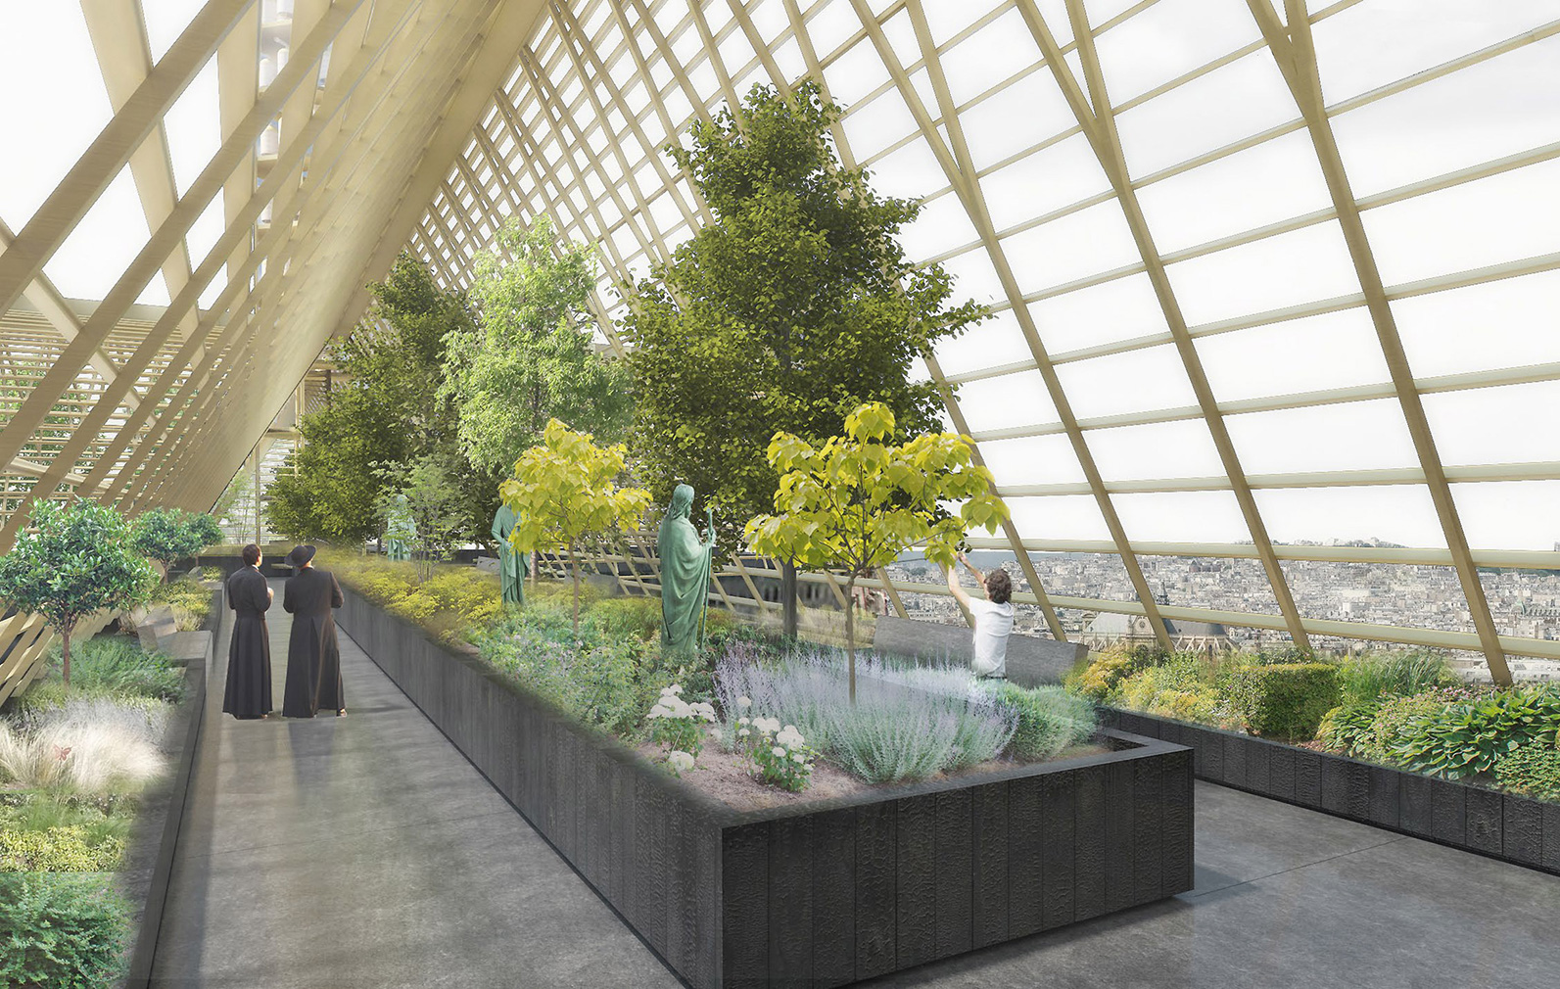
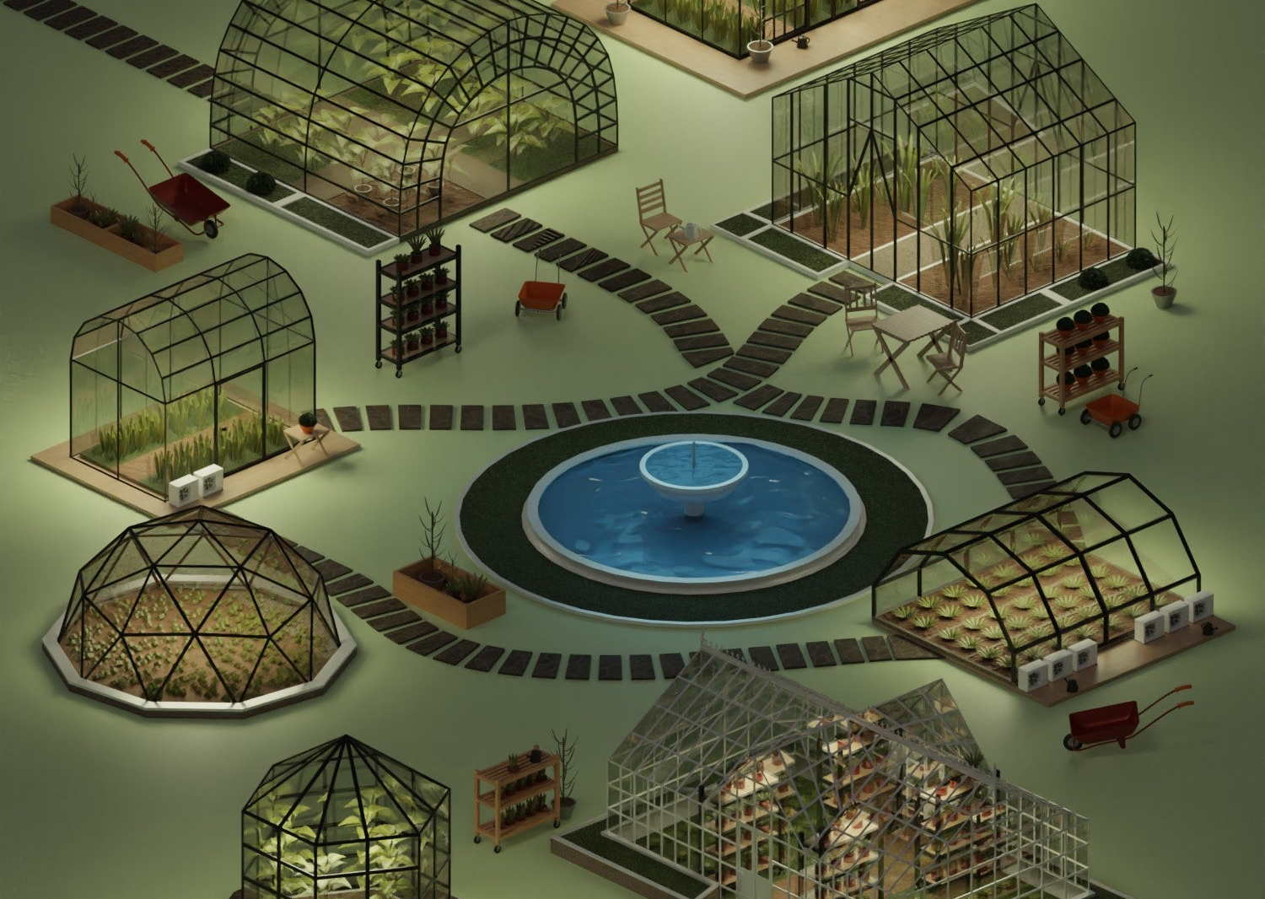
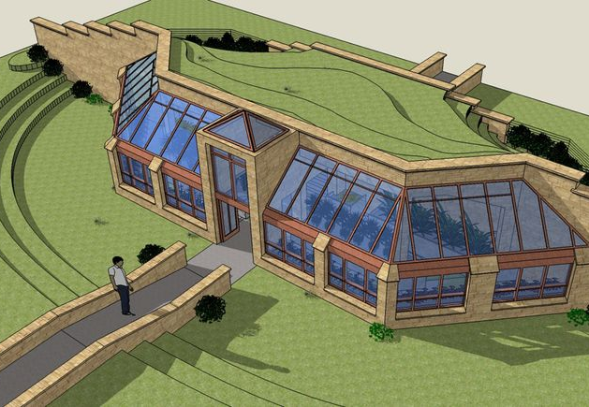
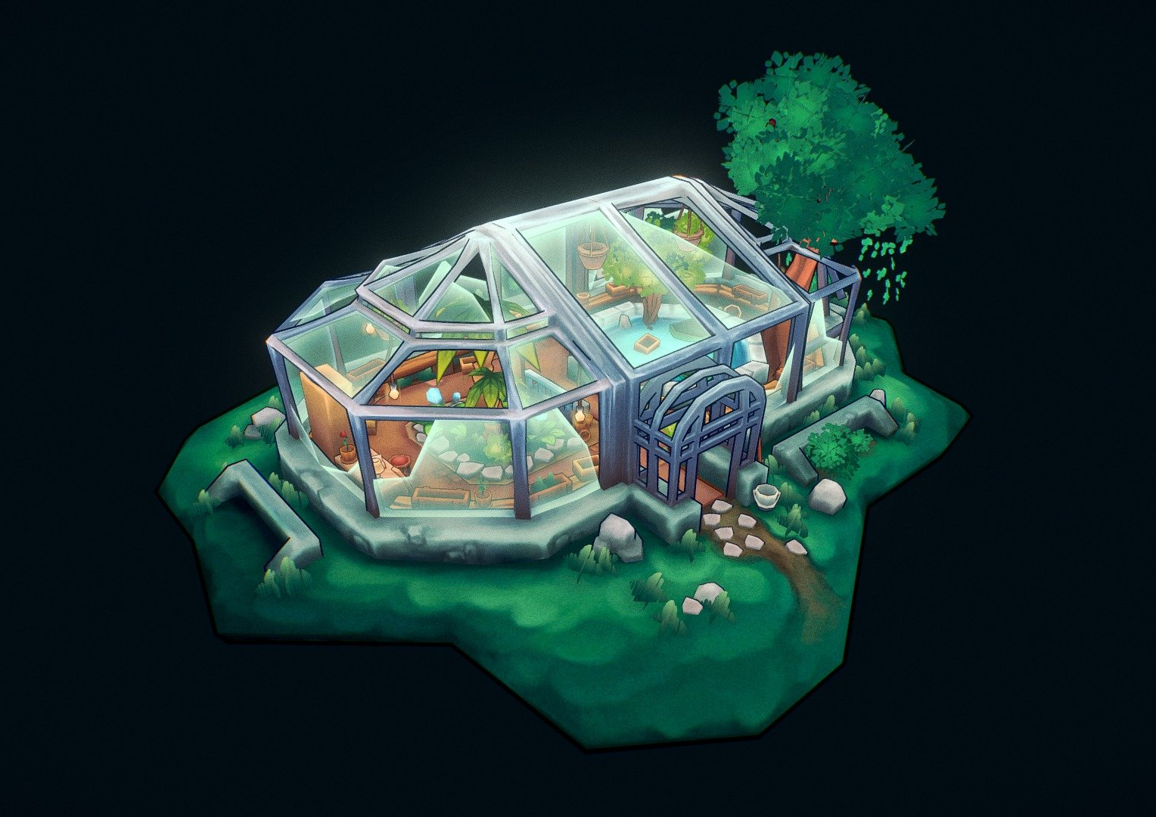
Environment
These are models of greenhouses, I will be taking inspiration from these in how I create the environment for my game, most of them use rectangular windows to form the shape they are looking for I will use rectangular windows too to build up the shape and for the interior there are a lot of mutated plants and greenery around

Slide 3
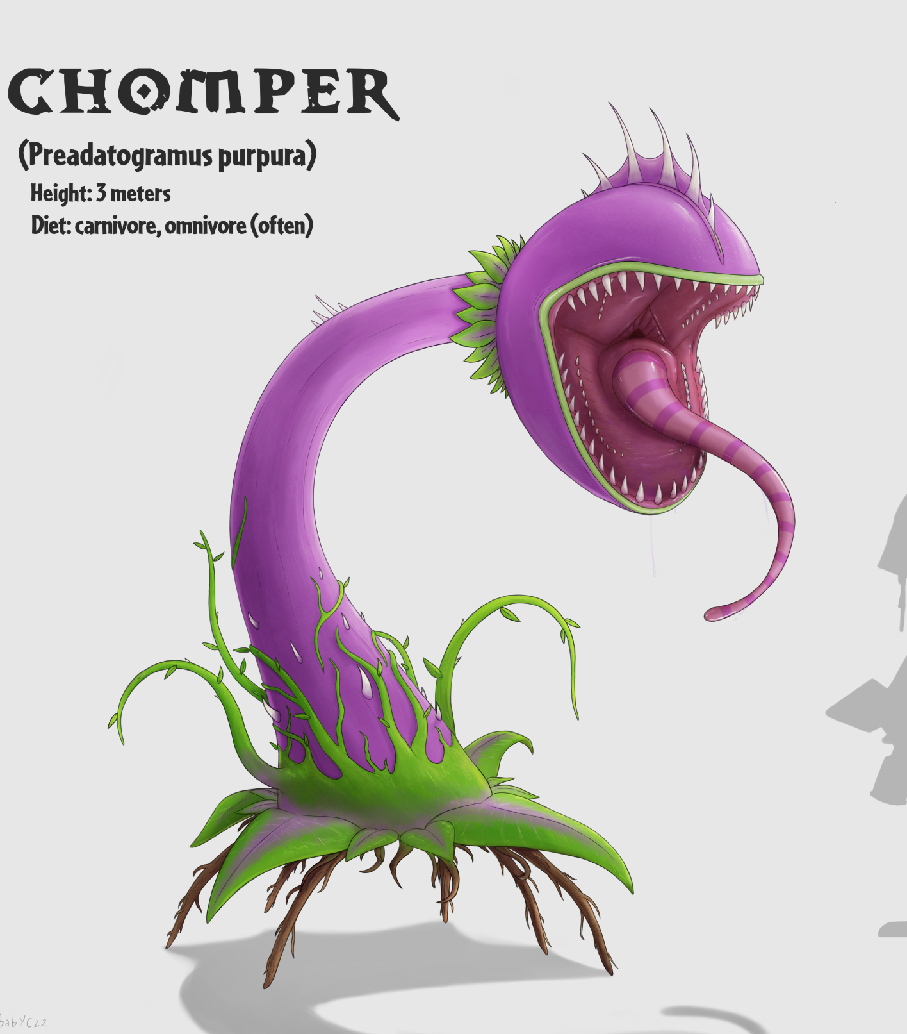

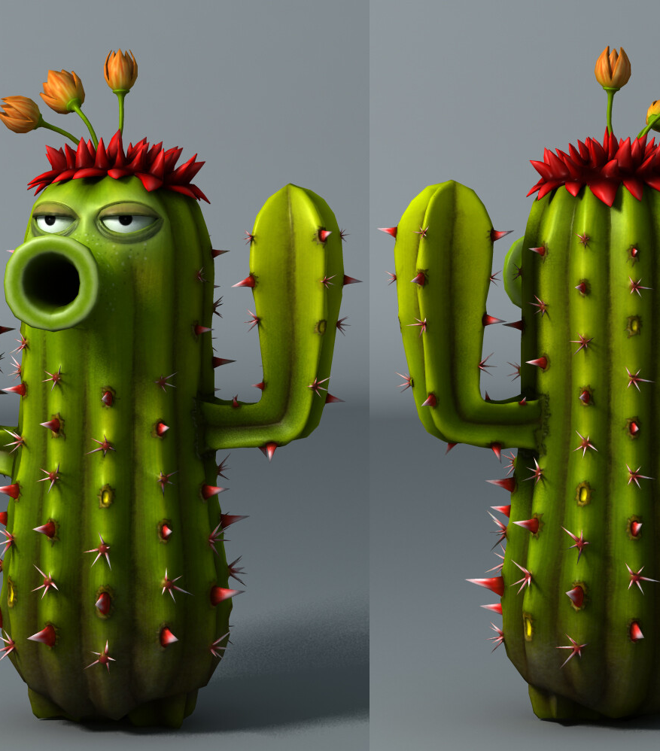
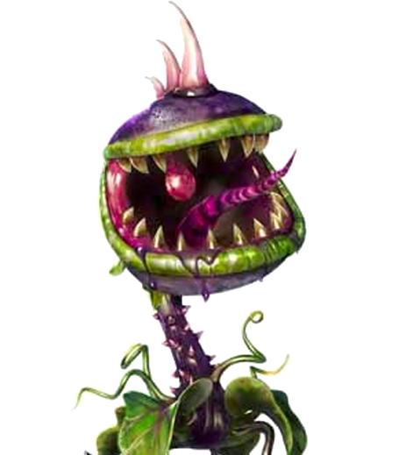
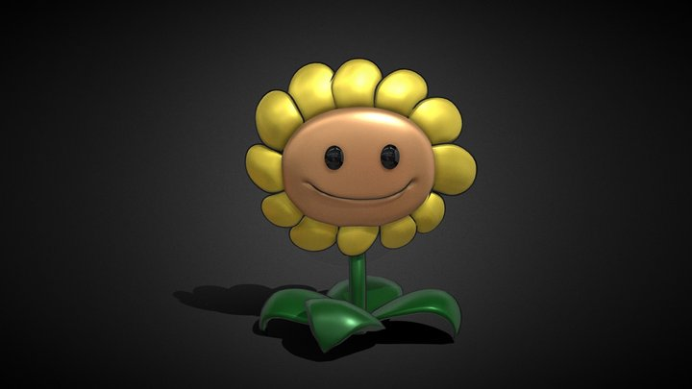
Plants
In these designs they all follow a similar style for a generailsed living plant design. I like the style of a plant with sharp teeth. I will be using a similar cartoony art style my designs will feature traditional animal features such as eyes and noses

Slide 4

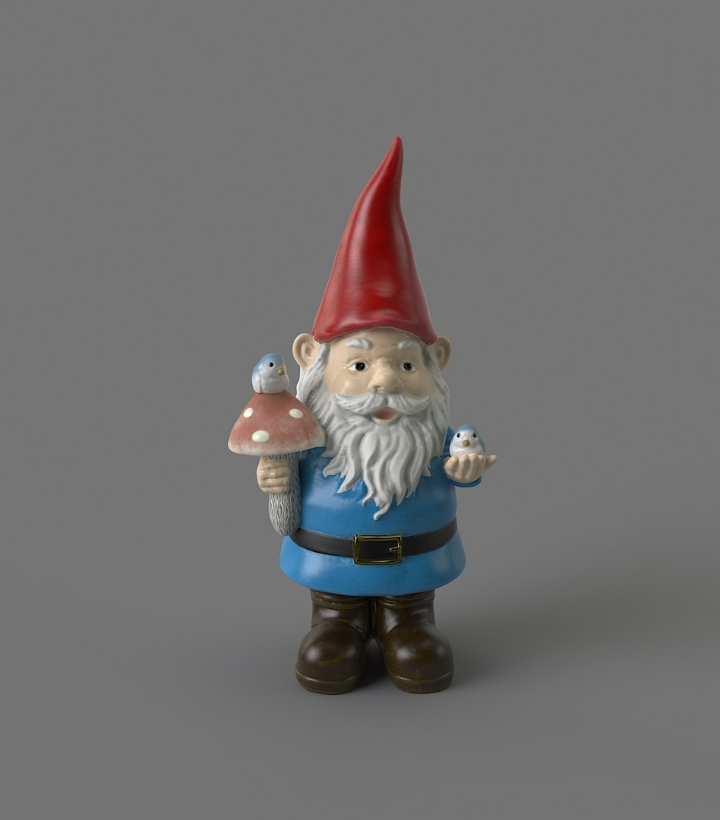
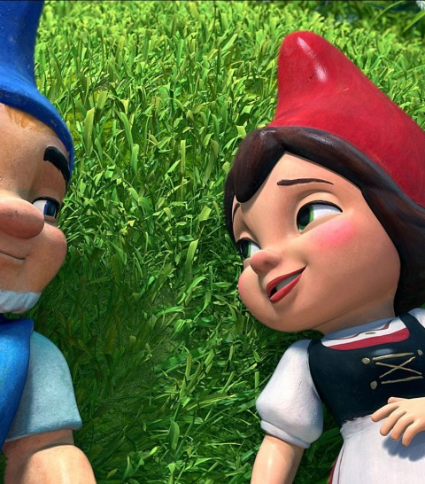
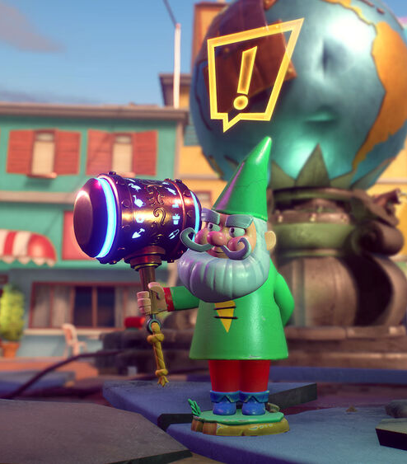


Gnomes
This is a bunch of gnomes that I am taking inspiration from, it is important for me to include the pointy red hat as all of the gnomes in this style have them. As well as this most of them have belts so I will include this too

Slide 5
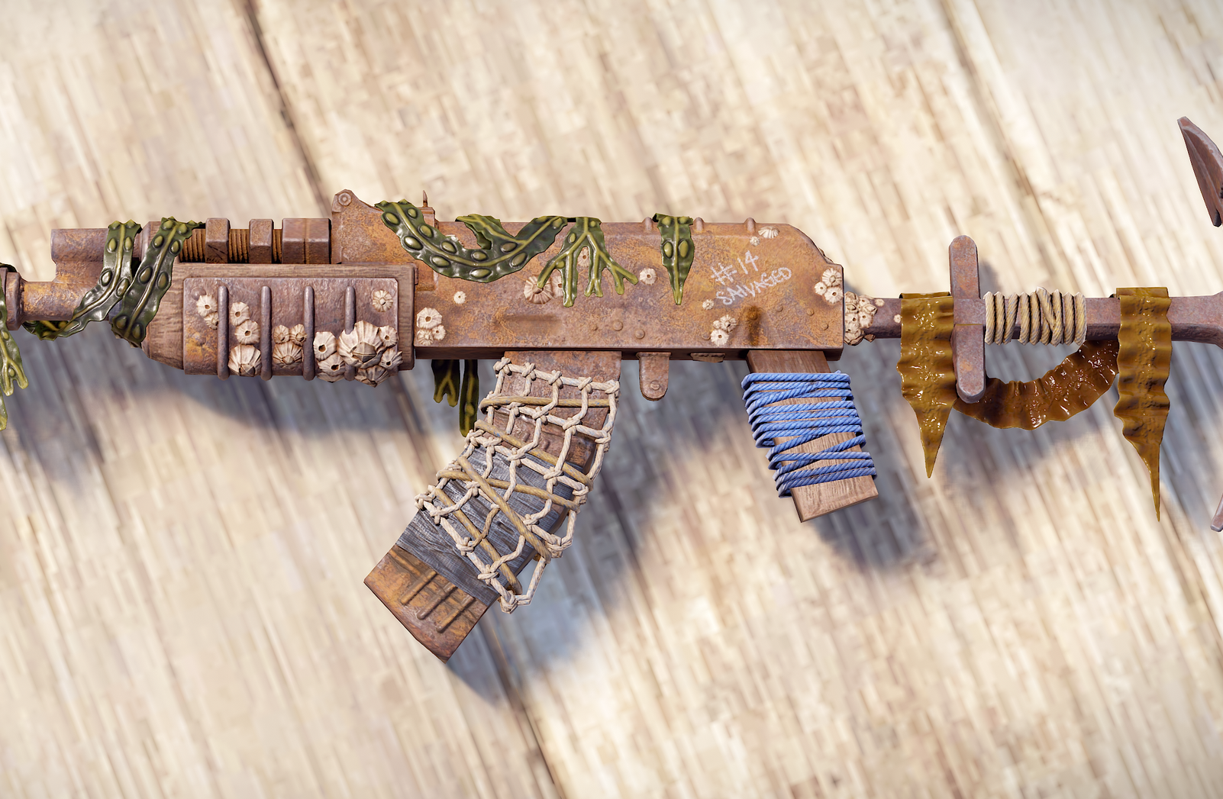

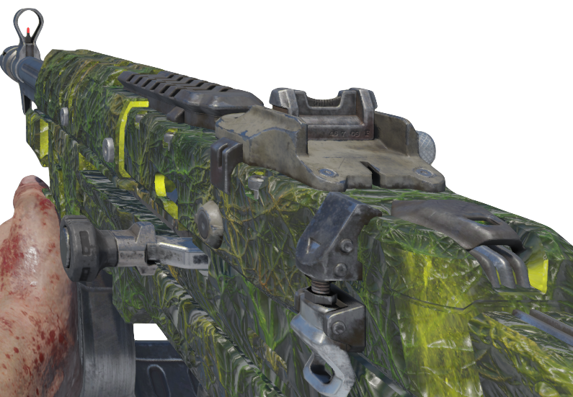
Guns
These guns have a specific look to them where vines wrap around the gun this is similar to how my upgraded guns will look in game, they will have a panning texture similar to black ops 3 zombies as a base colour for the gun and will have 3d vines wrap around the gun

Slide 6
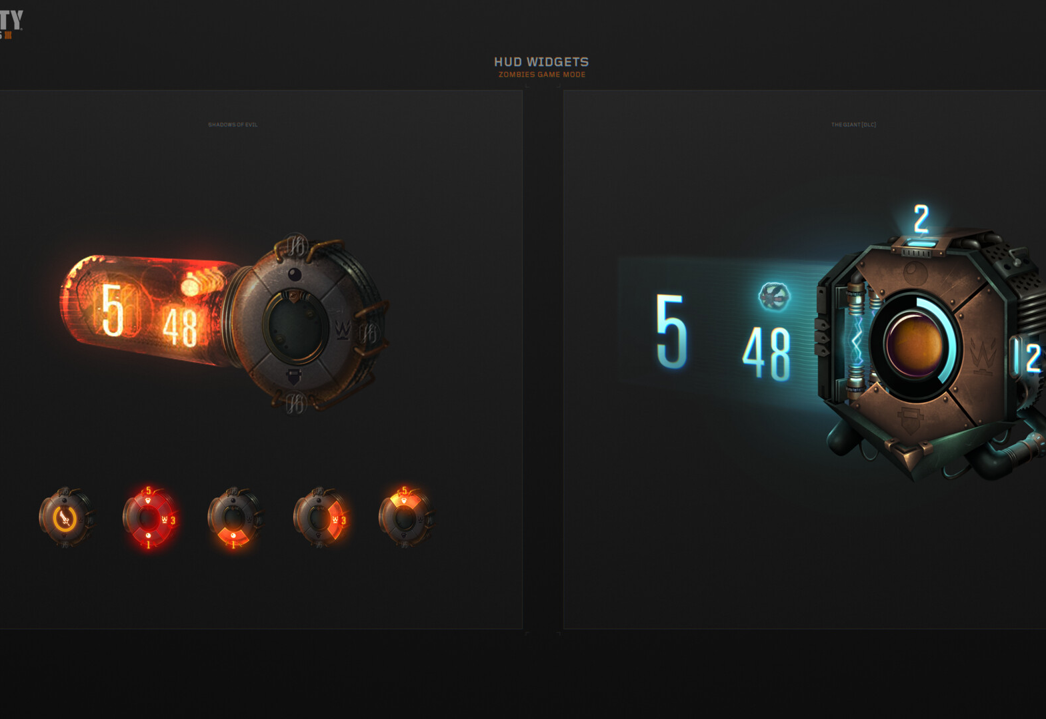
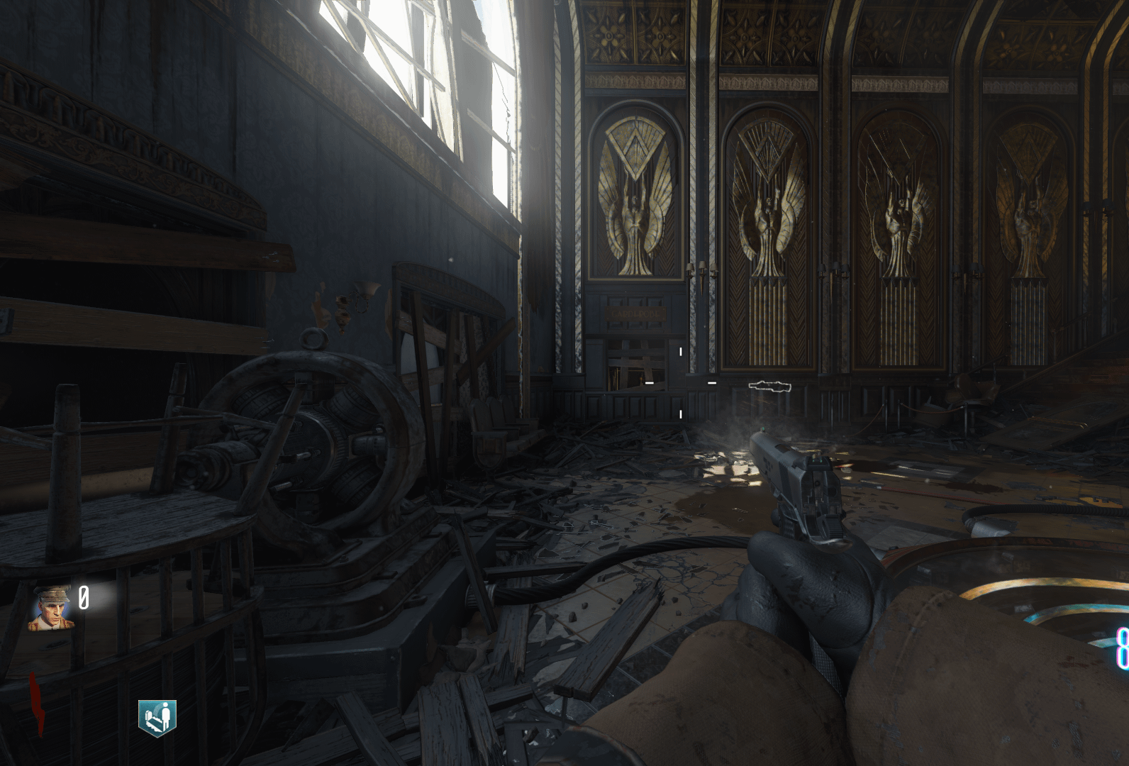
UI
I will have a similar UI to Black ops 3 zombies consisting of a points counter, round counter and ammo counters my UI will be layed out differently and none useful information will only stay on screen for a short time such as the name of the gun being held, this only needs to display when changing to a new gun rather than at all times

Slide 7
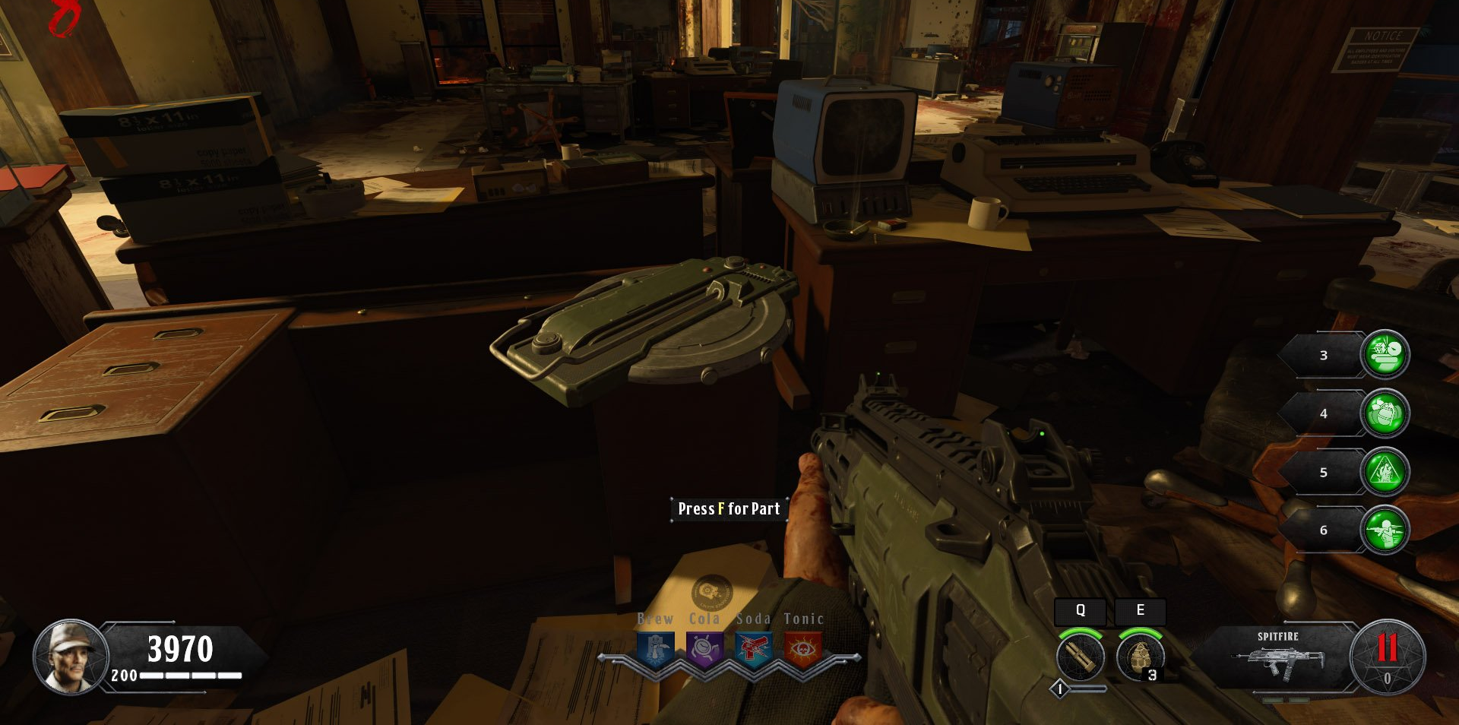
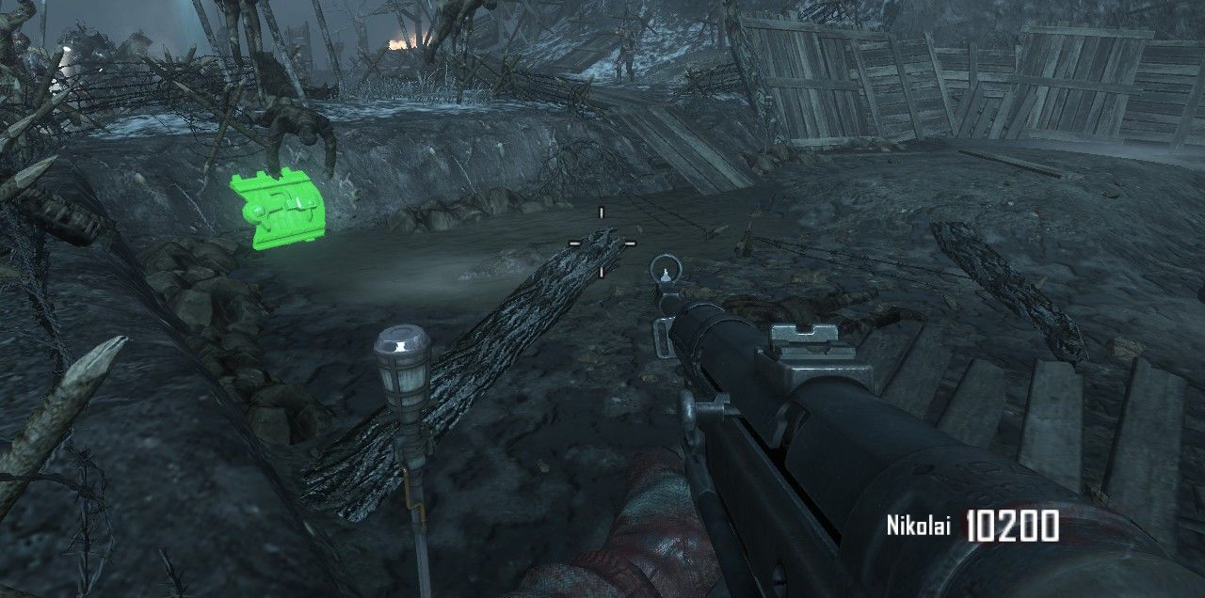
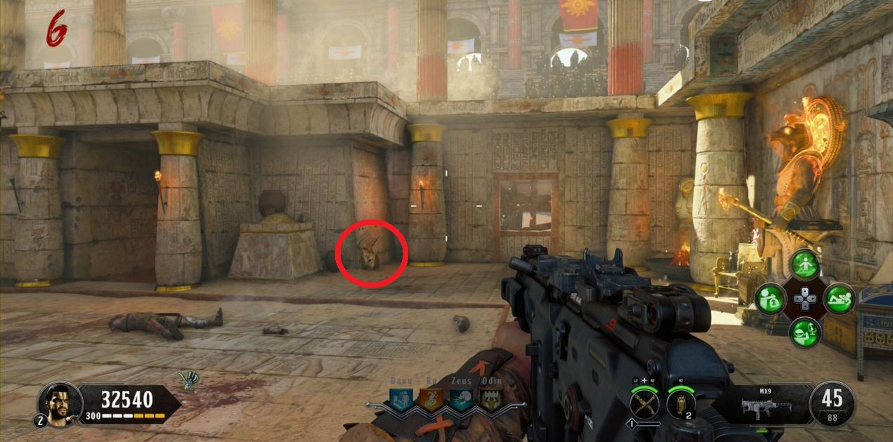
interactables
My game will have interactable seeds around the map that the player can find and use to plant the plants that will help the player to survive as the rounds go on. They will be found in the environment where the player will be able to interact with them and pick them up

Slide 8
Bibliography
Anon, 3D Garden Gnome - TurboSquid 1930955 [online]. Turbosquid.com. Available at: https://www.turbosquid.com/3d-models/3d-garden-gnome-1930955 [Accessed 20 October 2023 a].
Anon, 3D garden gnome model - TurboSquid 1223072 [online]. Turbosquid.com. Available at: https://www.turbosquid.com/3d-models/3d-garden-gnome-model-1223072 [Accessed 20 October 2023 b].
Anon, 3D model greenhouse [online]. Toffu Co. Available at: https://toffu.co/en-at/products/3d-model-greenhouses [Accessed 20 October 2023 c].
Anon, Botnomorphia: Chomper [online]. Deviantart.com. Available at: https://www.deviantart.com/kittygirlxjanax/art/Botnomorphia-Chomper-927352999 [Accessed 13 October 2023 d].
Anon, Earthship greenhouse designs [online]. Pinterest. Available at: https://www.pinterest.com/pin/64950419602135747/ [Accessed 20 October 2023 e].
Anon, Garden Gnome With Open Hand 3D - TurboSquid 1972477 [online]. Turbosquid.com. Available at: https://www.turbosquid.com/3d-models/garden-gnome-with-open-hand-3d-1972477 [Accessed 20 October 2023 f].
Anon, Gnome Chompski [online]. Left 4 Dead Wiki. Available at: https://left4dead.fandom.com/wiki/Gnome_Chompski [Accessed 20 October 2023 g].
Anon, Mr. Lucky [online]. Plants vs. Zombies Wiki. Available at: https://plantsvszombies.fandom.com/wiki/Mr._Lucky [Accessed 12 November 2023 h].
Anon, Pin on housebabytattoo [online]. Pinterest. Available at: https://www.pinterest.com/pin/housebabytattoo--664562488764151020/ [Accessed 3 November 2023 i].
Anon, PVZ Plant Character Models, Gordon Wang [online]. ArtStation. Available at: https://www.artstation.com/artwork/KO208X [Accessed 12 November 2023 j].
Anon, Steam Community :: Guide :: Tier list for all the weapons in BO III Zombies [online]. Steamcommunity.com. Available at: https://steamcommunity.com/sharedfiles/filedetails/?id=758313788 [Accessed 3 November 2023 k].
Anon, 2022. Stylized Mangrove Greenhouse - Download Free 3D model by Bársh (@borsh_and) [eBook]. Available at: https://sketchfab.com/3d-models/stylized-mangrove-greenhouse-4ad533f838f44fa583683ab7939c6aa1 [Accessed 20 October 2023].
Anon, 2021. Sunflower (Plants vs. Zombies) - Download Free 3D model by KillerBear [eBook]. Available at: https://sketchfab.com/3d-models/sunflower-plants-vs-zombies-a5a7d590bd0a4288b489c1421aa59c14 [Accessed 20 October 2023].
Anon, Nocookie.net. Available at: https://static.wikia.nocookie.net/gardenwarfare_gamepedia/images/3/3e/Chomper_front.PNG/revision/latest/scale-to-width-down/275?cb=20160224122152 [Accessed 13 October 2023 l].
Anon, Plutonium.pw. Available at: https://forum.plutonium.pw/topic/16186/bo2-zombies-ez-2-see-parts-origins-retexture [Accessed 12 November 2023 m].
Bugs, 2023. Abyss update preview — [online]. Rustafied. Available at: https://www.rustafied.com/updates/2023/6/29/abyss-update-preview [Accessed 3 November 2023].
Chandler, S., 2018. How to unlock the Pack-a-Punch in Classified - Call of Duty: Black Ops 4 Zombies [online]. Shacknews. Available at: https://www.shacknews.com/article/107974/how-to-unlock-the-pack-a-punch-in-classified-call-of-duty-black-ops-4-zombies [Accessed 12 November 2023].
CriesOfFurya, 2018. COD Black Ops 4: IX - How to Build the Zombie Shield [online]. PowerPyx. Available at: https://www.powerpyx.com/cod-black-ops-4-ix-how-to-build-the-zombie-shield/ [Accessed 12 November 2023].
Duran, M., Black Ops III : Zombies Game Mode UI, Miguel Duran [online]. ArtStation. Available at: https://www.artstation.com/artwork/rJzL9e [Accessed 12 November 2023].
EA, 2016. plants vs zombies garden warfare 2 [eBook]. Available at: https://store.steampowered.com/app/1922560/Plants_vs_Zombies_Garden_Warfare_2_Deluxe_Edition/.
Into Film, Gnomeo and Juliet [online]. Intofilm.org. Available at: https://www.intofilm.org/films/16615 [Accessed 3 November 2023].

